Slide 1
FLS Unit 1
DS 6371
Johnny Vogt

Slide 2
Quick Questions
A
A
A (against my better judgement, I put A for a third time)

Slide 3
Question 2
Both are ways to organize subjects of a study
An Random Sample is taken from a whole population and the key is to grasp accurate depiction of the “whole” population at a smaller scale
A randomized experiment is the process of creating control and independent groups in order to determine a causal inference. You would try to make sure that each participant would dhave a equal chance of being placed in any group in order to minimize any effect that a single subgroup in the population may affect the causation (reduce the confounding variable effect)

Slide 4
Question 3
The sample that the Literary Digest sampled only their readers/subscribers, which could have a bias towards their own readers in general. It was likely not a very accurate sample of the the whole population of America, despite the volume of the voters.
The magazine sampled only people that had access to the magazine, had a phone, or a automobile. This definitely created a unbalanced sample, that didn’t accurately collect on citizens that couldn’t afford such luxuries at the time.

Slide 5
Question 4
- Based off the first design, the sampling is done by giving discounts to farmers who have bought the older fertilizers. This sampling have created a bias with farmers who had more money to buy your extra time. Although the outcome had more than 60 more bushels, it is not right to determine causality based off this study
In the second design, there was a much more defined process. Out of all the orders, the supplier chose who was able to receive the new fertilizer. The supplier was able to create a control as well, effictibely being ball .

Slide 6
Question 5
Assumption:
  H0: μIntrinsic = μExtrinsic or μIntrinsic – μExtrinsic = 0
    If the true means of both the Extrinsic and Intrinsic Groups are equal, than the difference between the means will be 0
  Ha: μIntrinsic ≠ μExtrinsic or μIntrinsic – μExtrinsic ≠ 0
    If the true means of both Grroups are not the same, than the difference between the two will not equal to 0
Sample Data and Difference in Means
  Intrinsic Mean – Extrinsic Mean = 19.88 -15.74 = 4.14
  How likely is this ^^^, Assuming that the true mean is 0

Slide 7
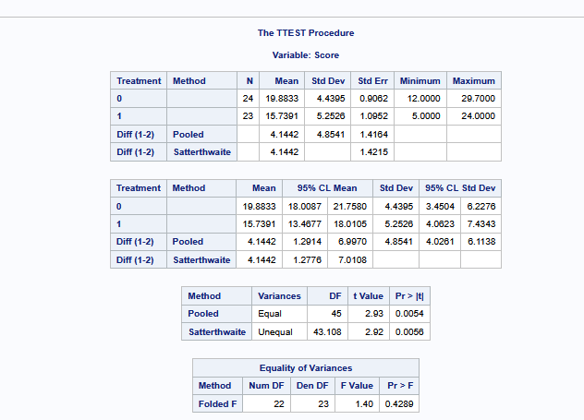
Q5. Continued
Ran a T-Ttest on just the sample data set
  Noted the Difference in means for future use

Slide 8
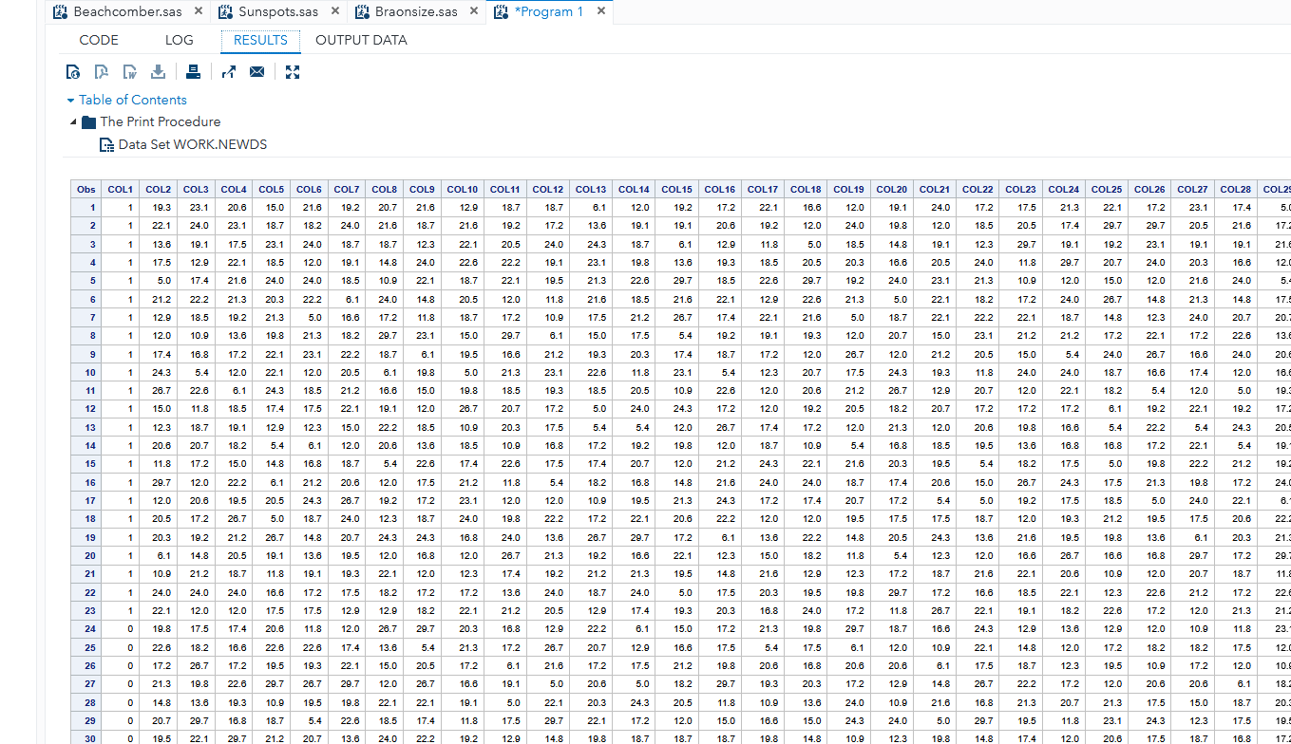
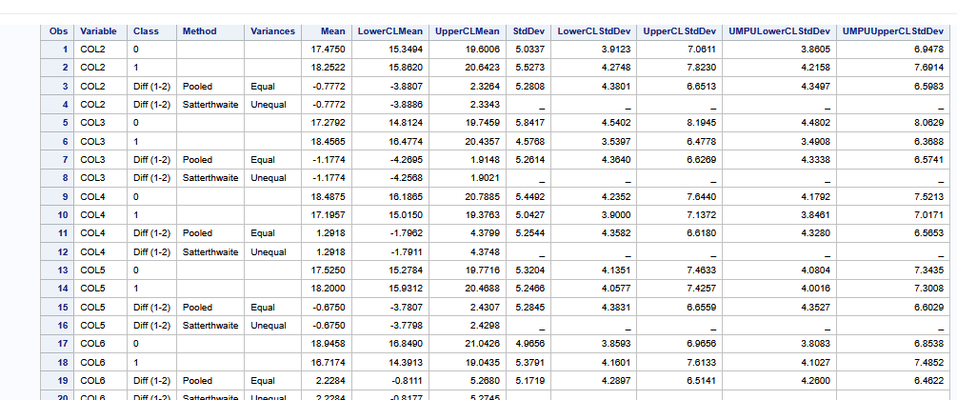
Q5: Permutation
Started the permutation test
  Only went up to 1000
Created a new dataset that calculated the difference in means in each permutation

Slide 9
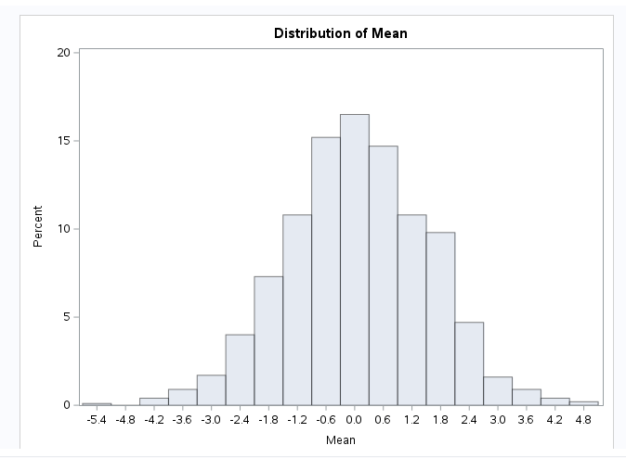
Q5: Histogram of the difference in means
The histogram consists of each permutation’s difference in means.
Given that in our sample the difference was 4.1442, you can see that it would fall towards the end of the tails, probably safe to assume that the probability of achieve that was low given the Null Hypothesis is true.

Slide 10
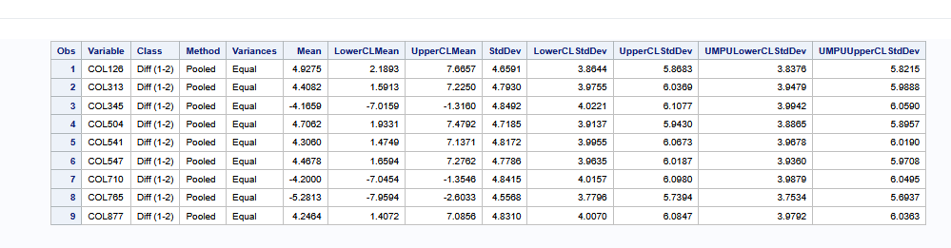
Q5 P-Value and Conclusion
9/1000 = .009 = P-Value
In my run, I had 9 instances where the difference in means were above or below 4.14/-4.14
Given that the differences between the true means of each group are 0 (Null Hypothesis is true) The probability of having a difference of 4.14 is .009.
Decision:
Since the probability of having a difference between sample means that is equal or greater than 4.14 is .009, it is very unlikely that the population mean is equal to each other. If the significance level set was to .05, we would reject the null hypothesis

Slide 11
Question 6: Takeaways
Could the Literary Digest have done anything to try to remediate the failure in sampling? Or was it doomed from the poor sample practice?
  Such cleaning the data, shown confidence intervals.
SAS is quite different from R
  R feels way more “freeform” with the way you can write
  SAS feels rigid
I’d like to see how run the same in R, just to see the difference.
Kind of want to go over more about scope of inference. Think I understand it, just seems to be the fuzziest part of the week for me.

